Slide 1
Taylor Series Revisited
by
Dr. Md. Rajibul Islam
CSE, UAP

Slide 2
Taylor Series Revisited

Slide 3
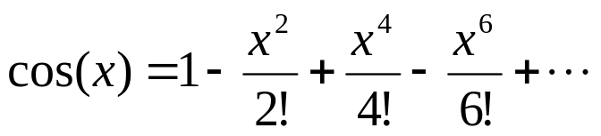
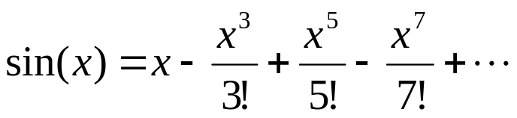
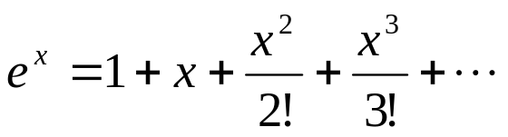
What is a Taylor series?
Some examples of Taylor series which you must have seen

Slide 4
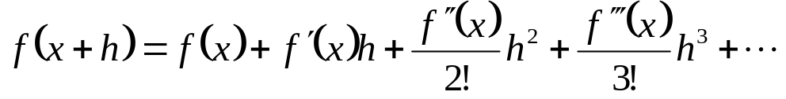
General Taylor Series
The general form of the Taylor series is given by
provided that all derivatives of f(x) are continuous and exist in the interval [x,x+h]
What does this mean in plain English?
As Archimedes would have said, “Give me the value of the function at a single point, and the value of all (first, second, and so on) its derivatives at that single point, and I can give you the value of the function at any other point” (fine print excluded)

Slide 5







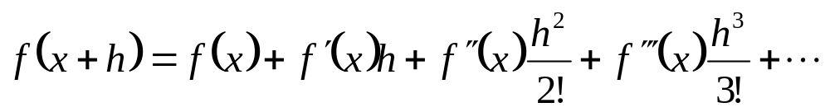

Example—Taylor Series
Find the value of
given that
and all other higher order derivatives
of
at
are zero.
Solution:

Slide 6
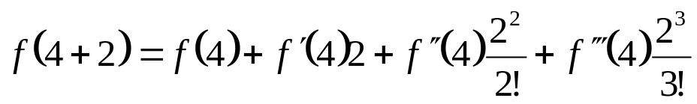
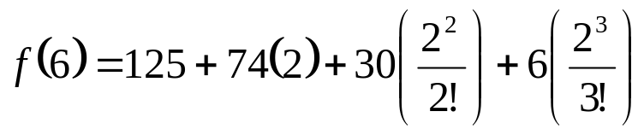


Example (cont.)
Solution: (cont.)
Since the higher order derivatives are zero,
Note that to find
exactly, we only need the value
of the function and all its derivatives at some other point, in this case

Slide 7
Derivation for Maclaurin Series for e^{x}
Derive the Maclaurin series
The Maclaurin series is simply the Taylor series about the point x=0

Slide 8

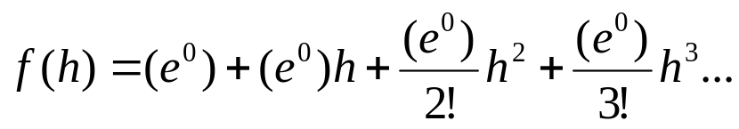
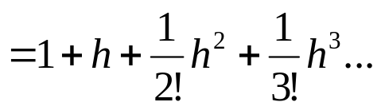
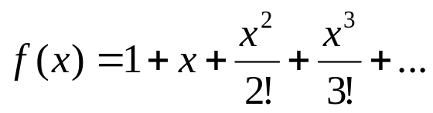
Derivation (cont.)
Since
and
[We know from the derivative calculus class]
the Maclaurin series is then
So, if we change h to x, because h is just a dummy variable in this series,

Slide 9
Additional Resources
Numerical Methods with Applications: Abridged (2nd Edition) – Autar Kaw, Egwu Kalu
  http://mathforcollege.com/nm/topics/textbook_index.html
Introductory Methods of Numerocal Analysis – S. S. Sastry
http://numericalmethods.eng.usf.edu

Slide 10
THE END

